Slide 1
User Interface In 3D Engines
A quick tour

Slide 2
Section Overview
Look at UI in game engines using the Unity engine as an example.
Intro: UI In Unity
Frame-based UI
Development Resources
Example Project
Notes:
While there are many engines out there, we’re talking about Unity because a) it’s what we’ve used, and b) it’s what others will likely use because of cost and features.

Slide 3
UI In UNITY

Slide 4
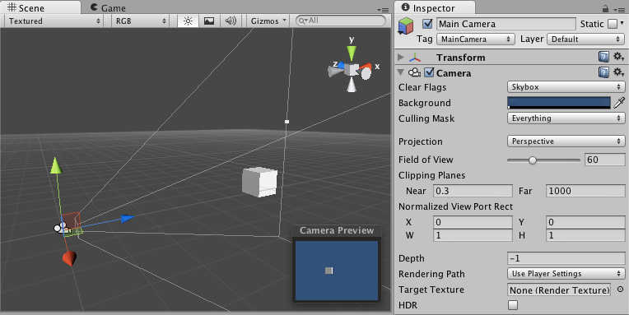
Starting UI
Inherently a 3D system – UI is a 2D overlay
Two ways to do UI:
Component based
Frame (event) based

Slide 5
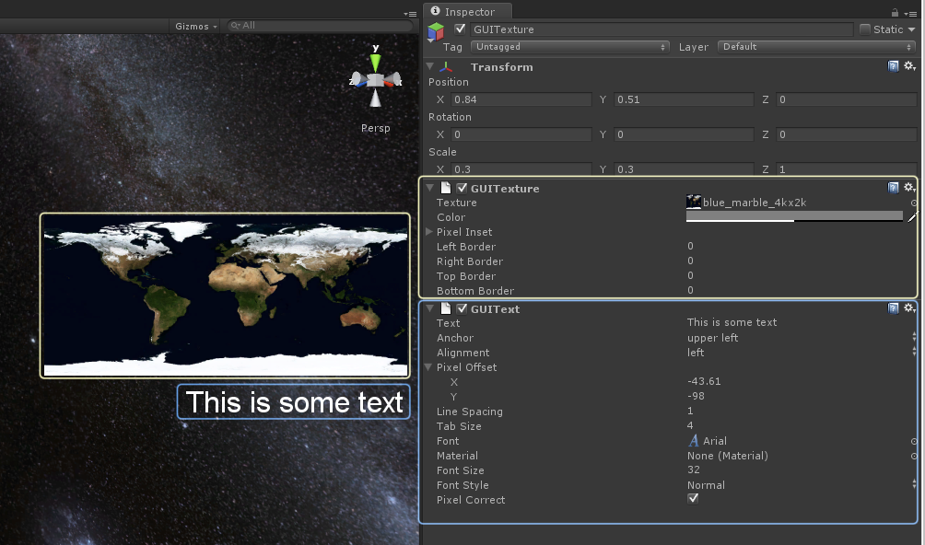
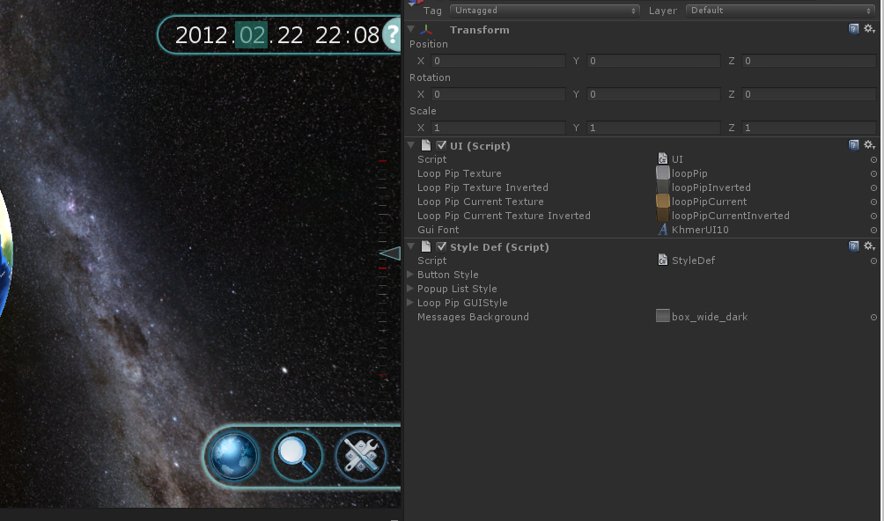
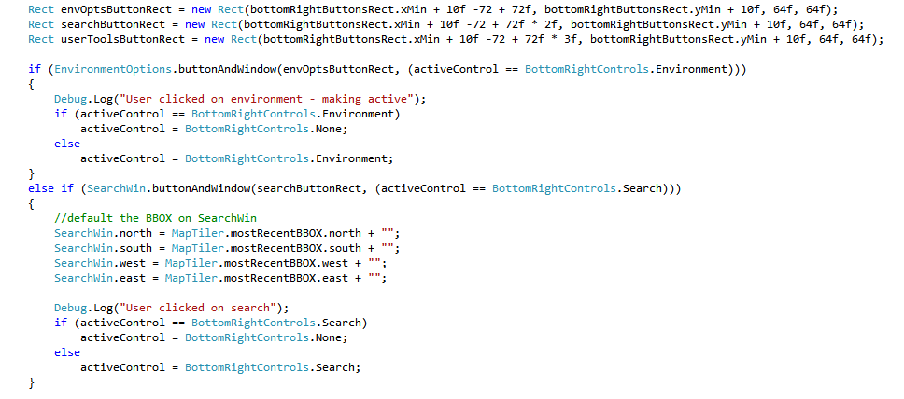
Component-based vs Frame-based

Slide 6
Frame-Based UI

Slide 7
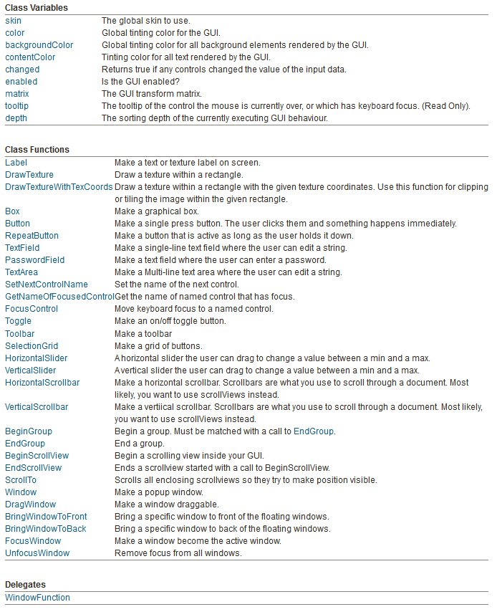
Layout and components
Manual and automatic layout
The GUI elements you’d expect

Slide 8
Downsides
No Visual/WYSIWYG layout tools
Basic GUI missing some elements
Traditionally, different use case

Slide 9
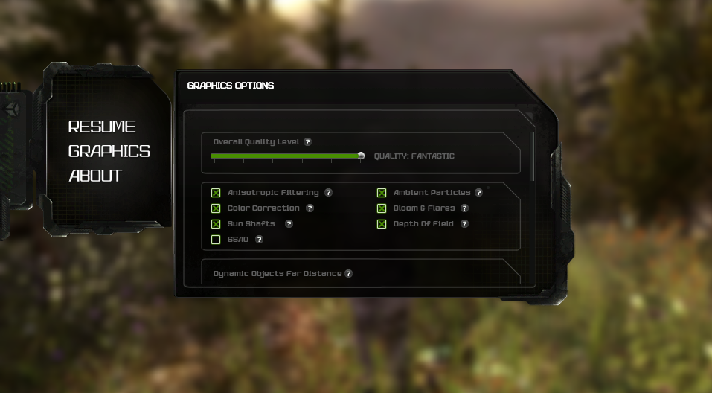
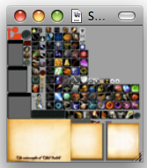
Game UI Design
Notes:
Show a game UI, talk about screen layout for these
Talk about sprite managers, atlasing

Slide 10
Development Resources

Slide 11
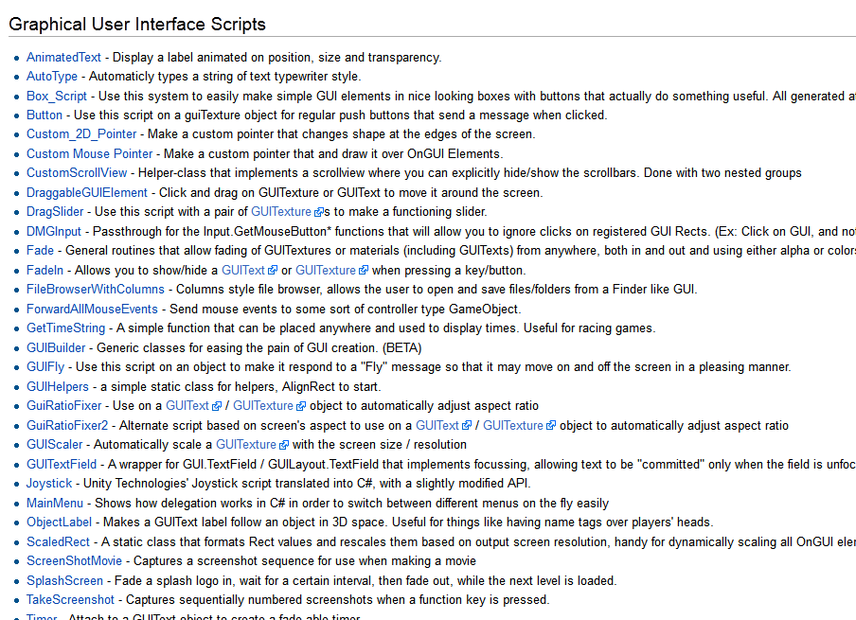
User community
Active forums, answer sites
Community wikis
Asset store

Slide 12
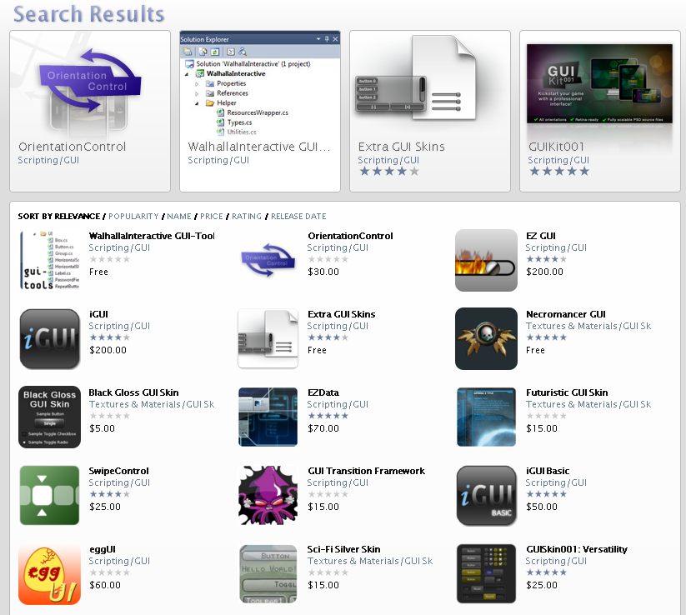
Frameworks

Slide 13
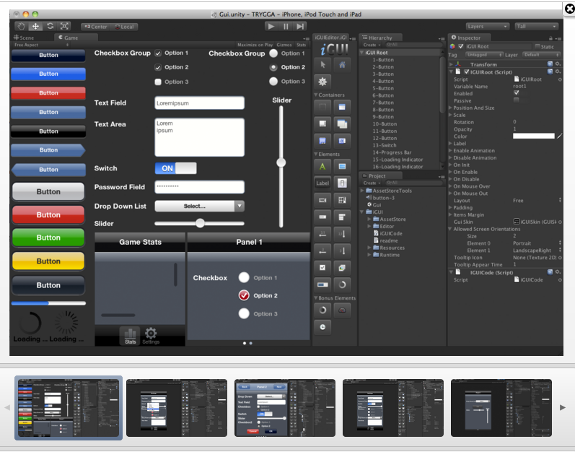
Frameworks

Slide 14
Example project

